Slide 1
Evaluating deep learning models for electricity price forecasting
Mia Zdybek

Slide 2
About me

Slide 3
Agenda

Slide 4
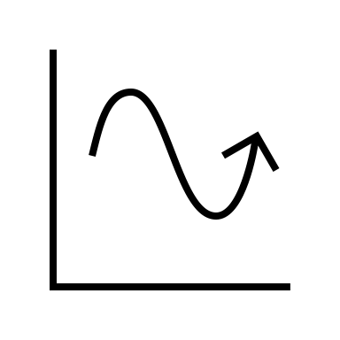
Objective
Find a relatively simple machine learning model that can predict spot prices 10-days ahead with good accuracy

Slide 5


Motivation
Benefits of spot price prediction
Improved strategies for purchasing and selling electricity (financial gain)
Plan production and consumption so that losses are minimized, and grid balance is kept (sustainability)

Slide 6

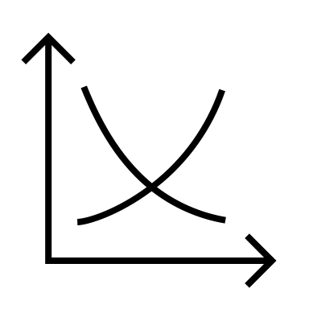

Problem
Electricity spot prices are unstable
Electricity spot prices depend on electricity demand and supply (and bidding strategies)
Demand and supply depend on unstable parameters:
- Weather
- Seasonal societal/behavior (holidays, weekly/monthly behavior)
- Politics
- Power source
- Transfer bottlenecks

Slide 7
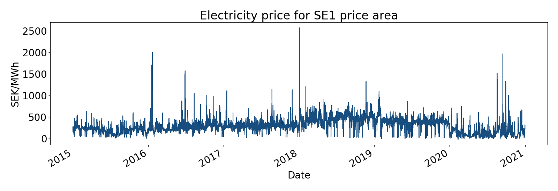
Spot prices
Erratic
Can change drastically from hour to hour

Slide 8
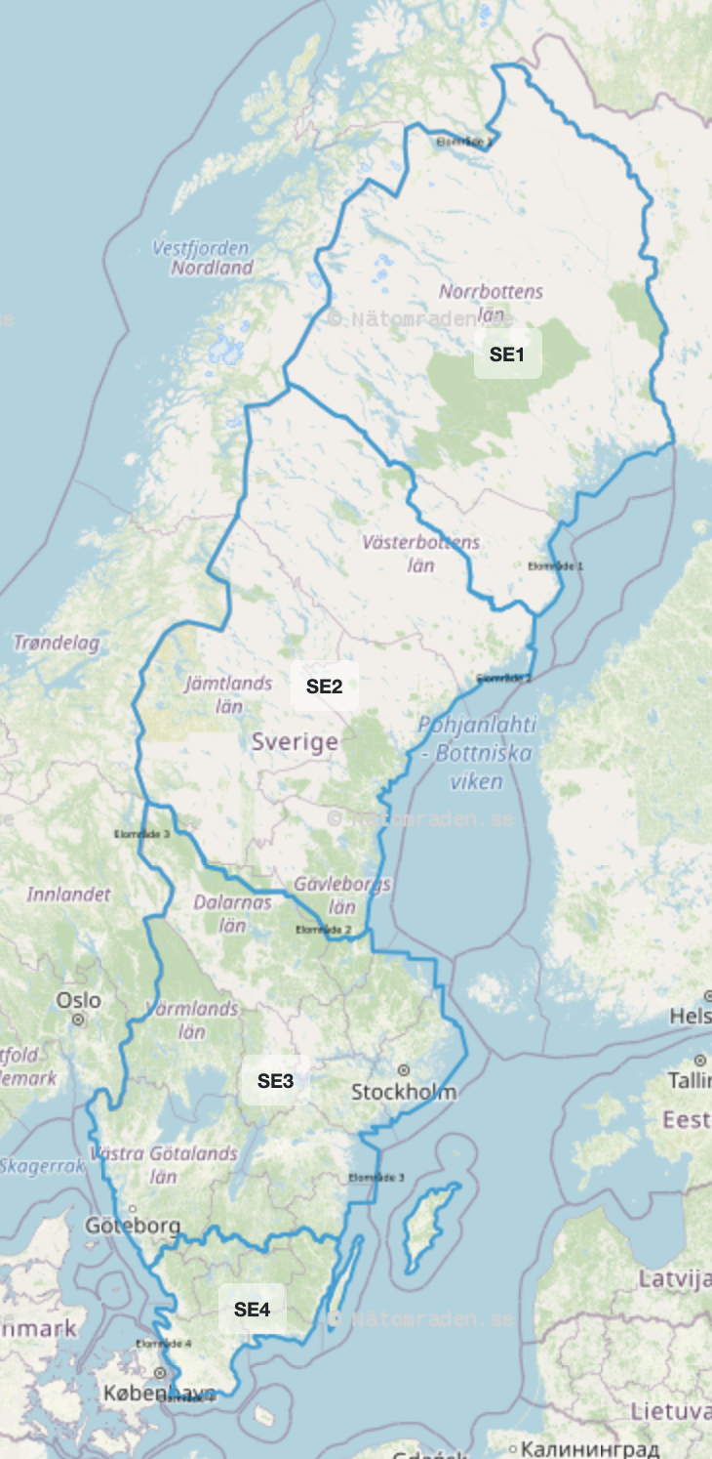
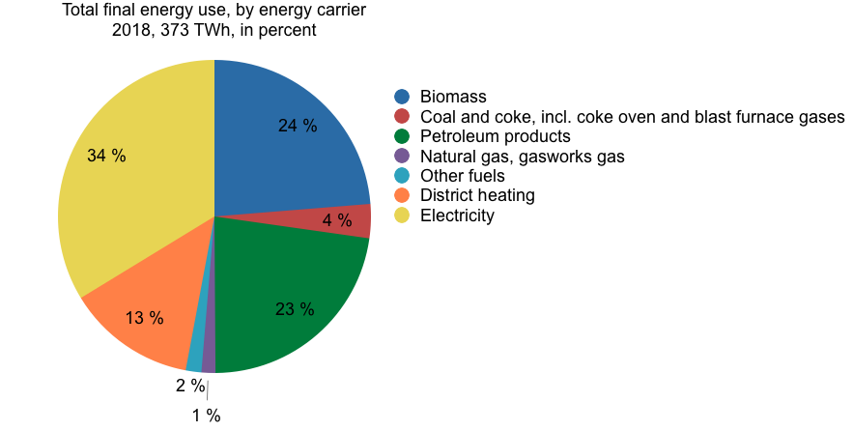
Electricity in Sweden
34 % of energy use was in electricity form in 2018
Mostly from hydropower and nuclear power
Renewable energy sources are increasing
Four price areas
Production/consumption deviation between north and south

Slide 9

Deep learning in EPF (Electricity price forecasting)
14 reviewed papers
Deep neural networks outperform other models, both machine learning and statistical models
The best performing model of the papers was usually LSTM, CNN and MLP or a hybrid of these

Slide 10

Method & Hypothesis
Method:
Gather relevant data
Build an LSTM, a CNN and an MLP
Evaluate them against each other and a benchmark model ARIMA
Hypothesis
”There is a relatively simple deep model that can predict spot prices 10-days ahead with high accuracy with the obtained data set”

Slide 11
Data
Nord Pool data
For each price area
Consumption
Consumption prognosis one day ahead
Production
Production prognosis for one day ahead
Wind power production prognosis
Hydro reservoir levels in Sweden
SMHI weather data
For each price area, average of
Air pressure
Air temperature
Wind speed·
Relative humidity
Cloud cover
Calendar variables
Month integer (1-12)
Weekday integer (1-7)

Slide 12
Data preprocessing
Min-max normalization of all data to [0,1]
Sequencing
70 % 15 % 15 % training, validation and test set split

Slide 13
Machine Learning

Slide 14
Short about the models
MLP LSTM CNN
Feed-forward
Output obtained by weight matrix multiplication put through activation function
Loops in connections
Node have 3 gates that perform operations to learn long-term dependencies
Convolution with help of weight kernel that capture features of data
Pooling reduces dimensions while summarizing features

Slide 15
Grid search obtained models
MLP LSTM CNN

Slide 16
Errors

Slide 17
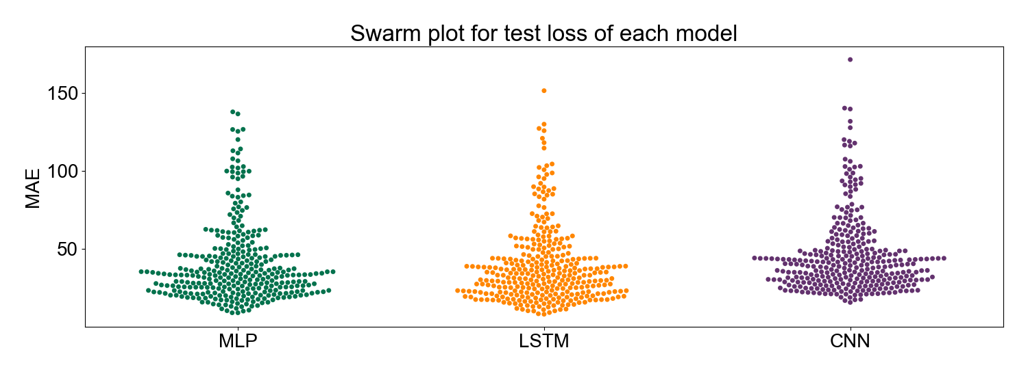
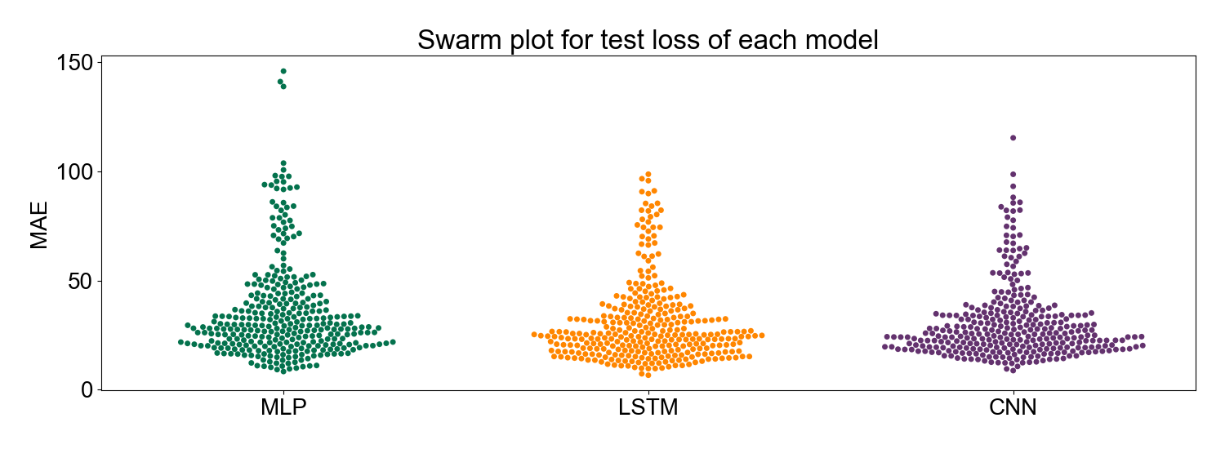
Errors

Slide 18
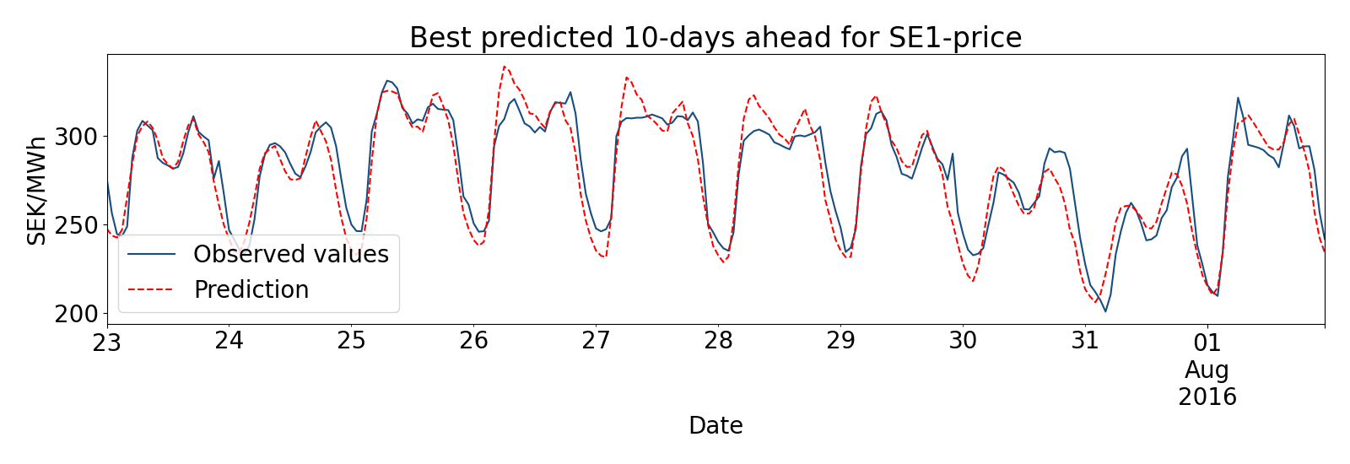
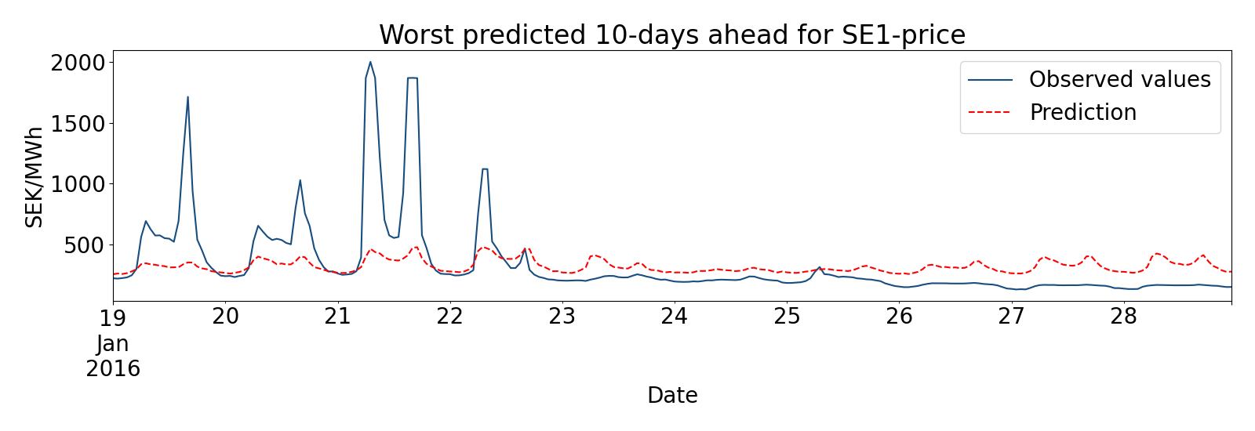
Results MLP
(weekly input)

Slide 19
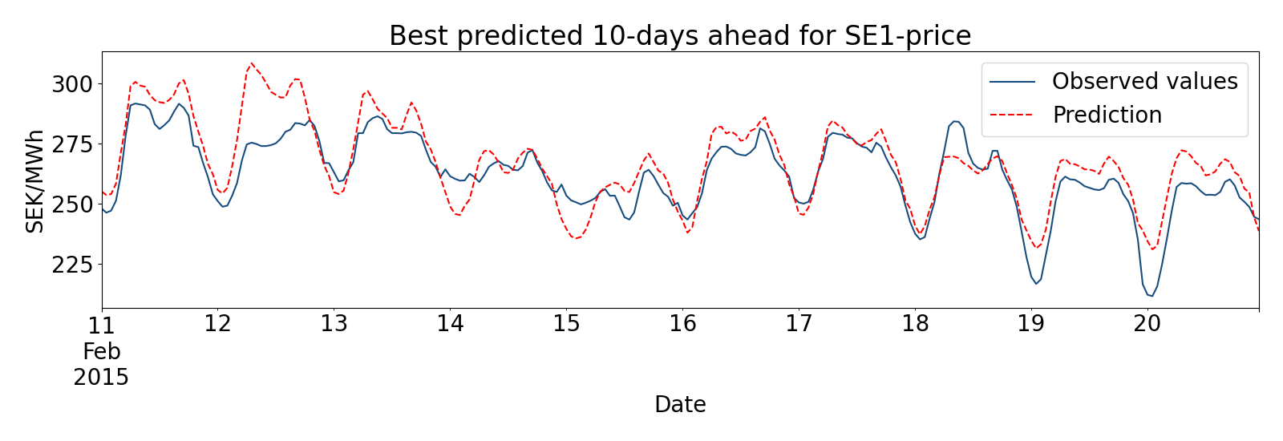

Results LSTM
(weekly input)

Slide 20
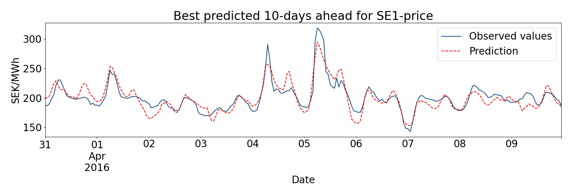
Results CNN
(weekly input)

Slide 21
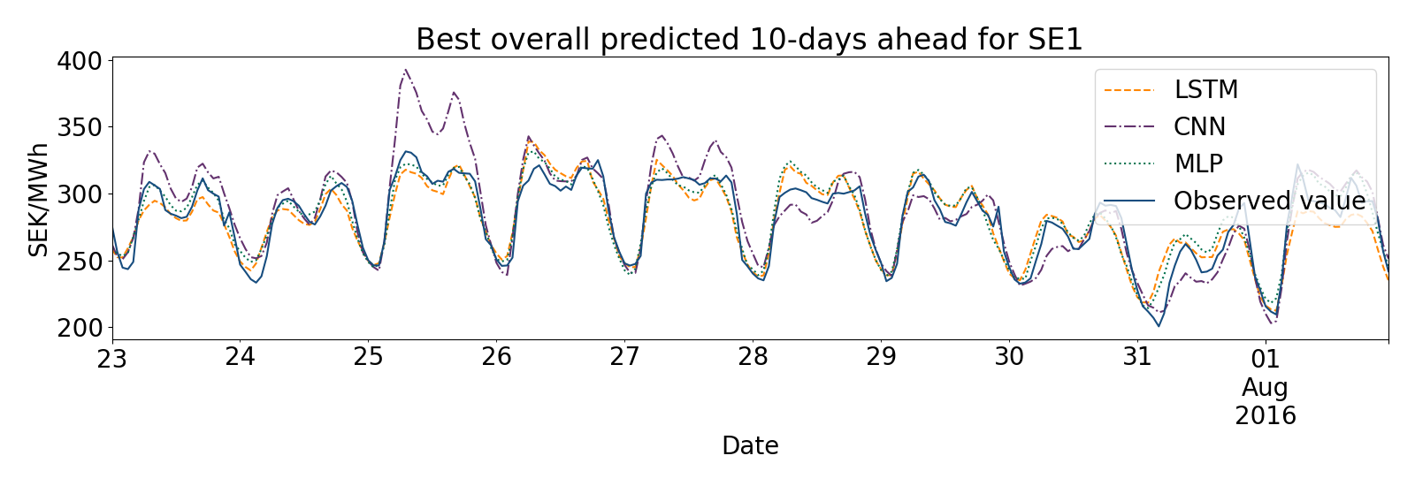
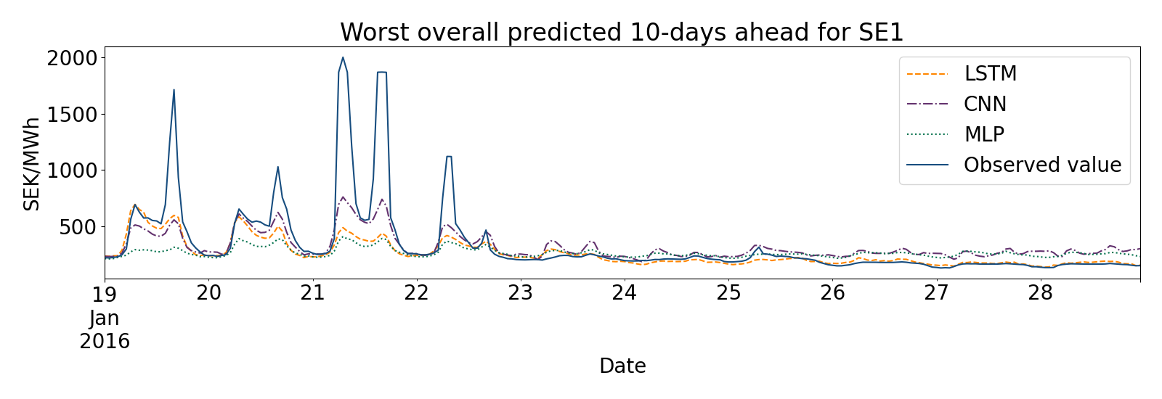
Comparison best and worst predictions

Slide 22
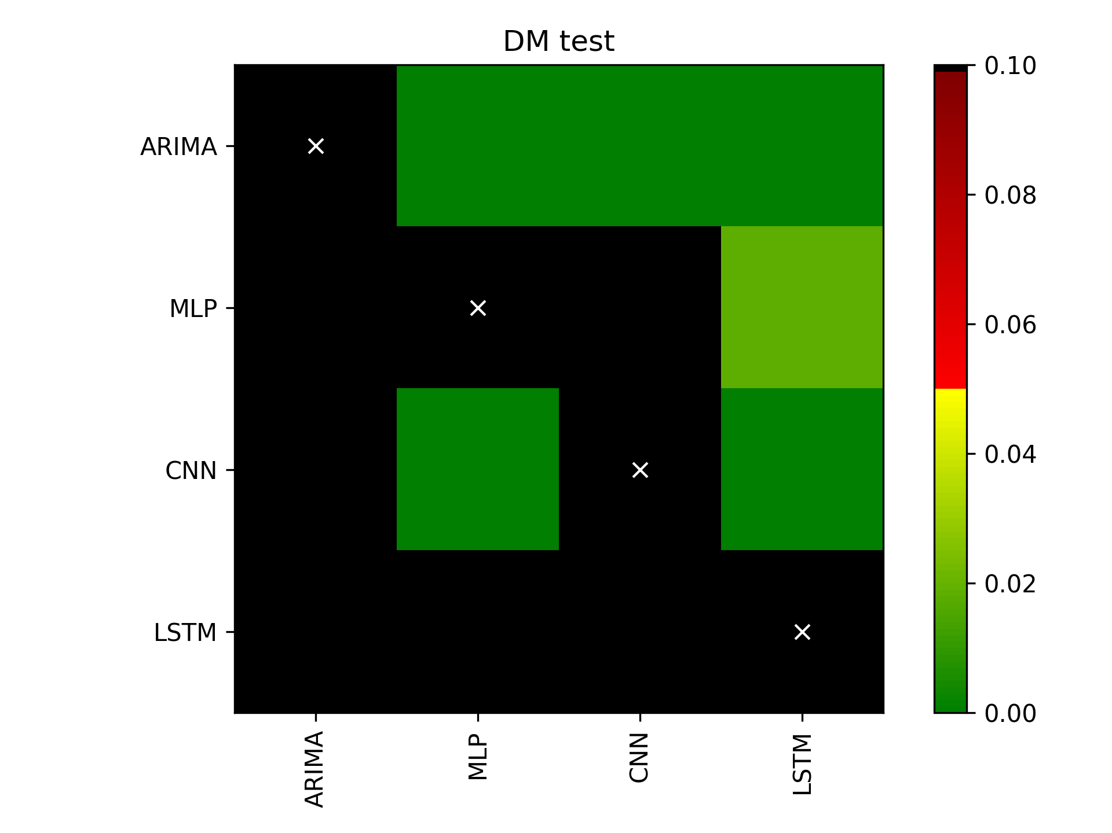
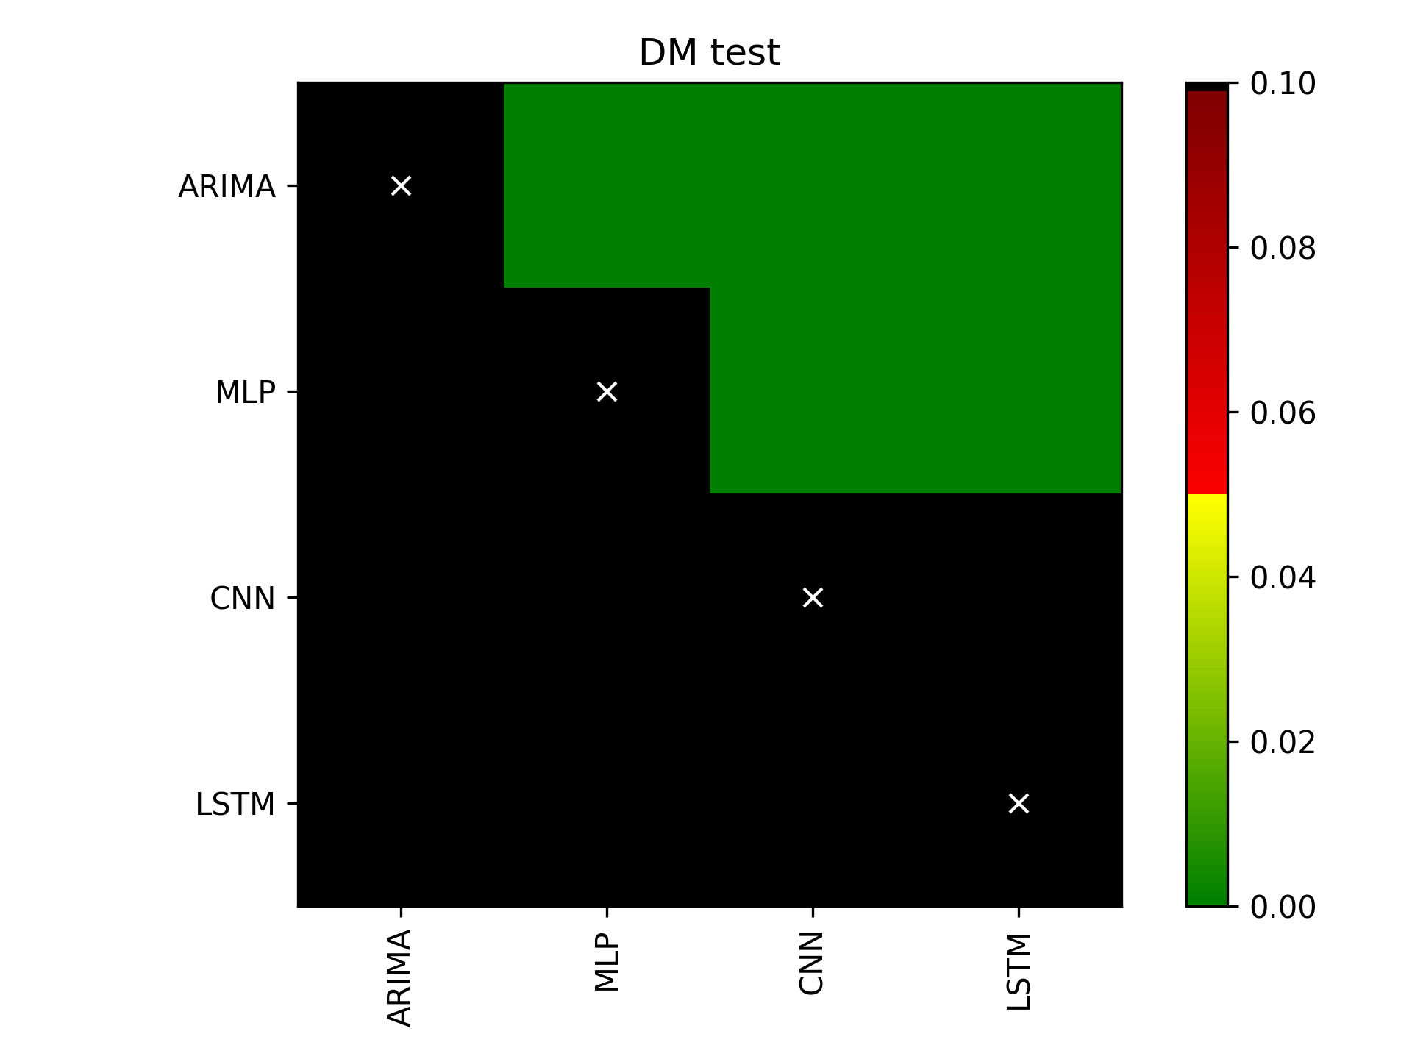
Diebold Mariano test

Slide 23
Randomly selected predictions LSTM

